Slide 2


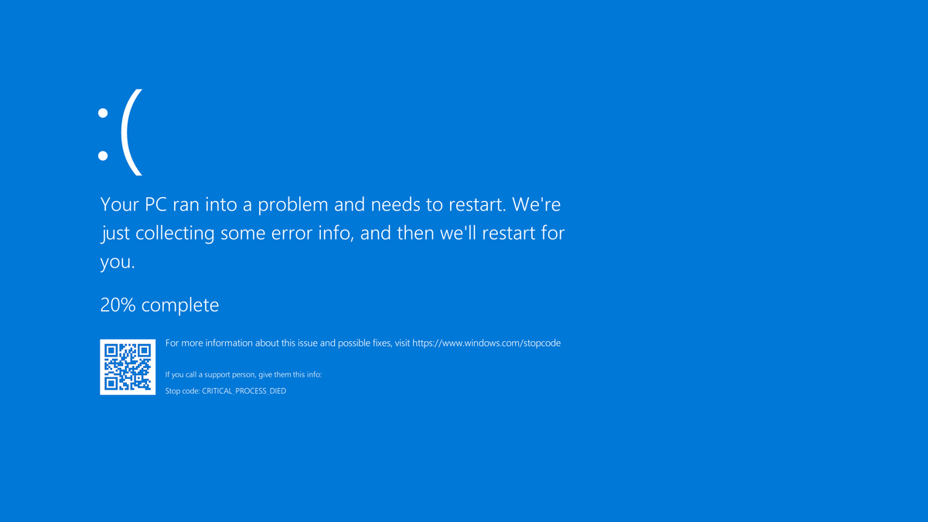

Non-persistence Concepts – Last Known Good
Boot configuration state
Use with boot failures
Overwritten with login

Slide 3



Non-persistence Concepts – Known State
Revert to known state
Baselines
Desired state configuration
Snapshots

Slide 4



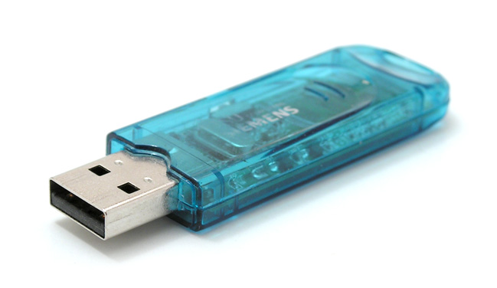

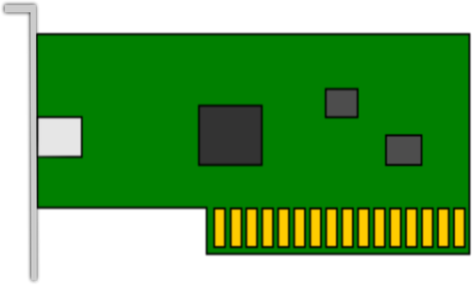
Non-persistence Concepts – Live boot media
Linux live boot
Recovery environments
Offline antivirus
Media
CD/DVD (Legacy)
USB
PXE boot (Network)

